Slide 1

DATA ANALYTICS INTERSHIPS BY INTERN INFOBYTE
Title: Customer Segmentation Using Clustering Techniques
Subtitle: K‑Means Clustering with Python on Kaggle Customer Data
Name: Karan kumar
Internship: INTERN INFOBYTE.IN
Date: 27/03/2026
Gmail: karankrtech@gmail.com

Slide 2
DATA ANALYTICS INTERSHIPS BY INTERN INFOBYTE
2: Agenda
Project Objective
Dataset Overview
Exploratory Data Analysis (EDA)
Data Preprocessing
Determining Optimal Clusters (Elbow & Silhouette)
K‑Means Clustering Results
Cluster Analysis & Interpretation
Business Insights & Recommendations
Conclusion & Future Work

Slide 3
DATA ANALYTICS INTERSHIPS BY INTERN INFOBYTE
3.Project Objective
Segment customers based on their purchasing behavior using unsupervised machine learning.
Identify distinct customer groups to enable targeted marketing strategies.
Improve customer retention and optimize marketing spend.

Slide 4
DATA ANALYTICS INTERSHIPS BY INTERN INFOBYTE
4: Dataset Overview
Source: Kaggle – Mall Customers Dataset
Size: 200 customer records
Features:
Customer ID (unique identifier)
Gender
Age
Annual Income (k$)
Spending Score (1‑100) – based on purchase behaviour
No missing values

Slide 5
DATA ANALYTICS INTERSHIPS BY INTERN INFOBYTE
5: Tools & Libraries Used
Python – Jupyter Notebook environment
Pandas, NumPy – data manipulation
Matplotlib, Seaborn – data visualization
Scikit-learn – scaling, K‑Means, silhouette score

Slide 6
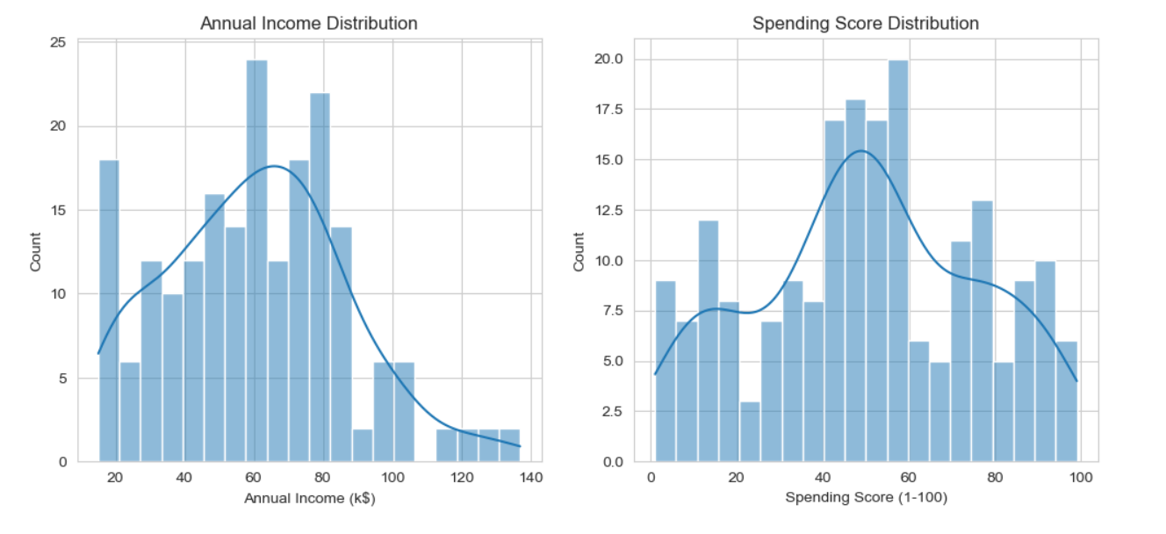
DATA ANALYTICS INTERSHIPS BY INTERN INFOBYTE
6: Exploratory Data Analysis (EDA)
Visualizing distributions to understand data patterns.
Visual:
Histogram of Annual Income – from your cell sns.histplot(df['Annual Income (k$)'], bins=20, kde=True).
Histogram of Spending Score – from your cell sns.histplot(df['Spending Score (1-100)'], bins=20, kde=True).
Observation: Annual income is roughly normal; spending score shows two peaks (low and high), suggesting natural groupings.

Slide 7
DATA ANALYTICS INTERSHIPS BY INTERN INFOBYTE
7: Feature Selection & Preprocessing
Text:
Selected features:
Annual Income (k$)
Spending Score (1‑100)
Reason: These two directly capture spending power and behavior.
Scaling:
Used StandardScaler to standardize features (mean=0, std=1).
Important because K‑Means is distance‑based; scaling ensures equal contribution.
Visual:
(Optional) Code snippet showing scaling:
python
scaler = StandardScaler()
X_scaled = scaler.fit_transform(X)

Slide 8
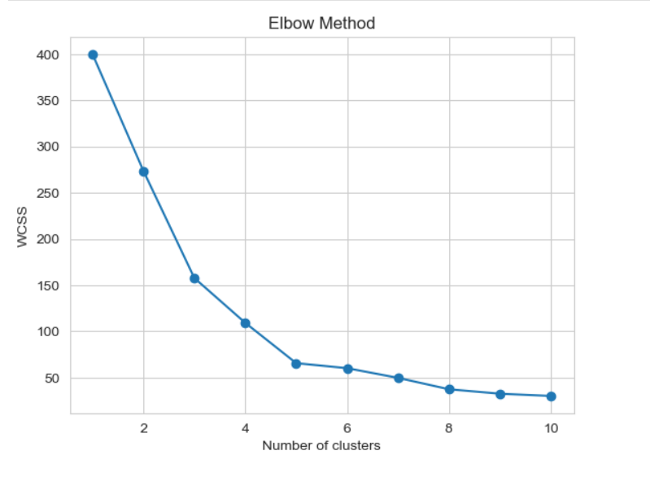
DATA ANALYTICS INTERSHIPS BY INTERN INFOBYTE
8: Determining Optimal Number of Clusters Elbow Method
Elbow Method: Plot of Within‑Cluster Sum of Squares (WCSS) vs. number of clusters (k).
The "elbow" point indicates the optimal k.
Visual:
Elbow plot from your cell plt.plot(range(1, 11), wcss, marker='o').
Caption: The elbow is visible at k=5.

Slide 9
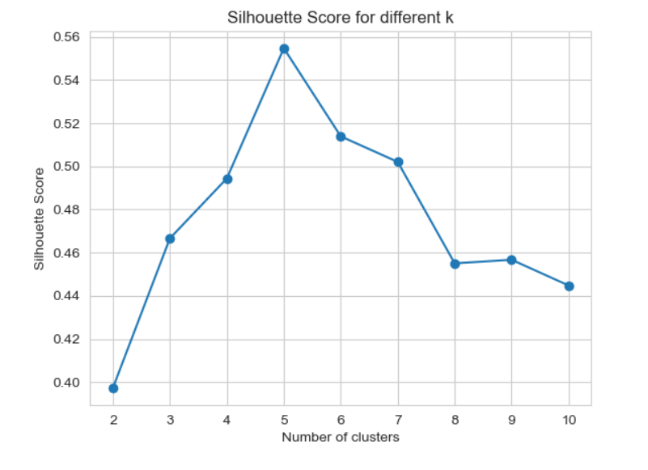
DATA ANALYTICS INTERSHIPS BY INTERN INFOBYTE
9: Determining Optimal Number of Cluster Silhouette Score
Text:
Silhouette Score: Measures how similar a point is to its own cluster compared to others. Higher score = better.
Result: The highest silhouette score is also at k=5.
Image:
Silhouette plot from your cell plt.plot(range(2, 11), sil_scores, marker='o').
Caption: Confirms k=5 as the optimal choice.

Slide 10
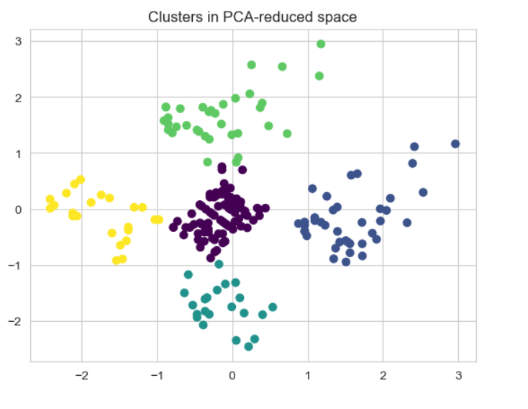
DATA ANALYTICS INTERSHIPS BY INTERN INFOBYTE
10.Applying K-Means with k=5
K‑Means algorithm with n_clusters=5, init='k-means++', random_state=42.
Each customer assigned to one of the five clusters.
Visual:
Final scatter plot (original scale) with points colored by cluster – from your cell plt.scatter(df['Annual Income (k$)'], df['Spending Score (1-100)'], c=df['Cluster'], cmap='viridis')

Slide 11
DATA ANALYTICS INTERSHIPS BY INTERN INFOBYTE
10: Cluster Characteristics (Profiling)
Text:
Grouped by cluster to compute average income, spending score, age, and majority gender.
Visual:
Table from cluster_summary (screenshot or formatted table):
Cluster | Avg Income (k$) | Avg Spending Score | Avg Age | Majority Gender | Segment Name
0 | 86.8 | 19.2 | 42.5 | Female | Careful Spenders
1 | 60.2 | 49.1 | 41.1 | Male | Average Customers
2 | 39.7 | 20.8 | 43.9 | Female | Economy Shoppers
3 | 39.0 | 79.0 | 25.5 | Female | Impulsive Buyers
4 | 87.6 | 81.8 | 32.4 | Male | Premium Customers

Slide 12
DATA ANALYTICS INTERSHIPS BY INTERN INFOBYTE
11: Visualizing Cluster Profiles
Compare average values across clusters to understand differences.
Visuals (three bar charts arranged side‑by‑side):
Avg Annual Income by Cluster – from sns.barplot
Avg Spending Score by Cluster – from sns.barplot
Avg Age by Cluster – from sns.barplot
Caption: Premium customers have high income and high spending; impulsive buyers are young with low income but high spending.

Slide 13
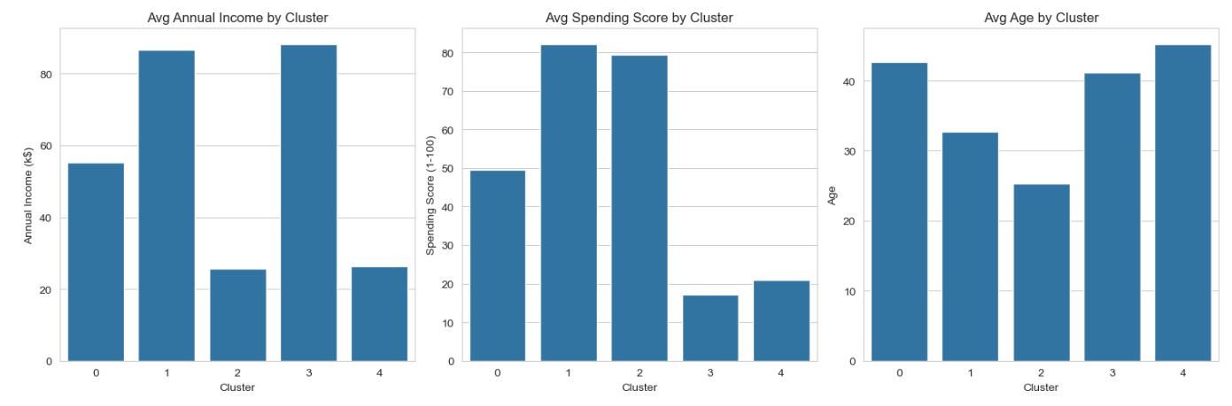
DATA ANALYTICS INTERSHIPS BY INTERN INFOBYTE

Slide 14
DATA ANALYTICS INTERSHIPS BY INTERN INFOBYTE
12: Business Insights & Recommendations
Premium Customers (Cluster 4): High income, high spending → VIP programs, exclusive offers.
Careful Spenders (Cluster 0): High income, low spending → value deals, bulk discounts.
Impulsive Buyers (Cluster 3): Low income, high spending → “buy now, pay later”, flash sales.
Average Customers (Cluster 1): Moderate → bundle deals, upselling.
Economy Shoppers (Cluster 2): Low income, low spending → essential products, price guarantees.

Slide 15
DATA ANALYTICS INTERSHIPS BY INTERN INFOBYTE
13: Conclusion
Successfully segmented customers into five meaningful groups using K‑Means.
Clusters reveal clear behavioral patterns based on income and spending score.
Provides actionable insights for targeted marketing.
Demonstrates the value of unsupervised learning in business analytics.

Slide 16
DATA ANALYTICS INTERSHIPS BY INTERN INFOBYTE
14: Future Work
Include additional features (Age, Gender) for finer segmentation.
Experiment with other clustering algorithms (DBSCAN, Hierarchical).
Use PCA for dimensionality reduction if more features are added.
Automate segment assignment for new customers.

Slide 17
DATA ANALYTICS INTERSHIPS BY INTERN INFOBYTE
THANK YOU !

